Slide 1
IEEE Central Texas Section
2019 Fall Leadership Planning Meeting
August 24, 2018
San Marcos, TX
Section Committee/Officer Name: Jose Lacavex
Chapter/Affinity Name: IEEE YP Austin
Prepared by: Jose Lacavex

Slide 2
Vision, Leadership Team
OU Name: IEEE YP Austin
Build a Team to help with organizing more frequent gatherings/meetups
Expand collaboration efforts with other IEEE chapters
Expand Social Media and Social Media Marketing efforts
Leadership Team
Position Name Email
Chair Jose Lacavex jaylacavex@yahoo.com

Slide 3
2019 Key Accomplishments
Meetings:
April – Top Golf Social/Networking Joint-Event with IEEE Grad Chapter at UT, L31 Filed
Upcoming, Sep – IEEE MTT & IEEE YP Technical Speaker/Social
Other Activities/Events:
Recruiting officers

Slide 4
2019 Chapter Vitality & Help Needed
Chapter Vitality Assessment (Strong, Ok, Need Improvement)
Attendance – We had a great turn out at the Top Golf event (29 people)
  The interest is there, need more active officers and frequent events
Relevance & Membership Recruitment – Improving, needs more
Finance – Fair, have not had issues getting funding but holding frequent events outside of free venues/more attractive locations can drain budget quickly
Top Help Needed/Issues
Major need of officers
Dedicated social media person

Slide 5

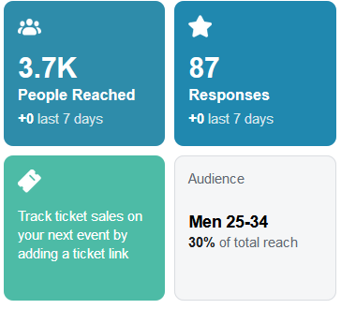
Others/Backup
Results of Experiment with Online Marketing
Ad Spend = $72.47
Freelance Ad Designer = $50.00
Total = $122.47
Results:

Slide 6
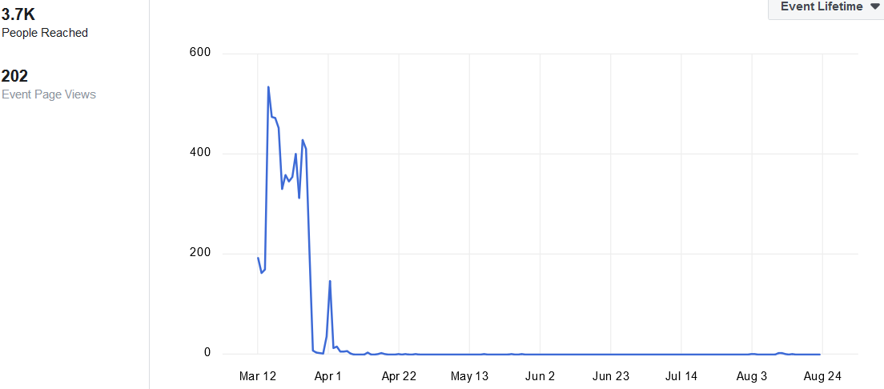
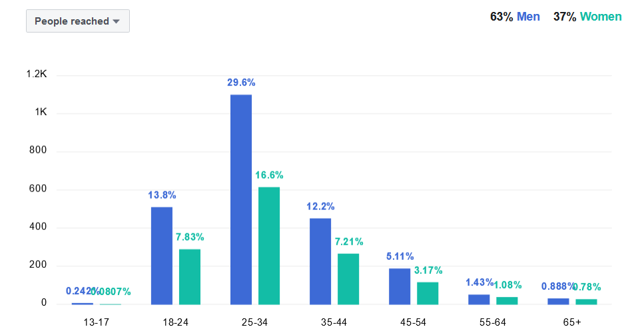
Others/Backup
Results of Experiment with Online Marketing
Ad ran for 15 days (March 12 – March 27
3.7K People saw it
202 Visited the Event Page

Slide 7
Others/Backup
Results of Experiment with Online Marketing
Ad had to be turned off before the intended date because the event was overbooked.
Mixed crowd of STEM and other corporate fields
19 non-IEEE members that were interested in the organization/signed up to our email list/Facebook page

Slide 8
CTS Leadership
CTS Officers
Chapters/Affinity
Standing Committees/Coordinators
Chair
Fawzi Behmann
Vice Chair – A
Heena Rathore
Vice Chair – SA
Nils Smith
Secretary
Treasurer
Bill Martino
Past Chair
Leslie Martinich
Student Branch
Student Branch Chapters
Strategic Plan
Policies and Procedures PARP
Awards and Recognition
Nomination Committee
Election Committee
FIN/Audit Committee
Membership Development
Electronics Communications
Website
Communications Portal
Conferences/Events
Section-Chapter Vitality Chair
K-12/STEM Educational Activities
Students Activities
Professional Activities – PACE
Outreach Program
Conferences/Events

